Slide 1

Chess Detector
宋嘉菲，袁远，林宇森，翁如嵩，覃昕
指导老师：高盛华
2016.12.20
1

Slide 2
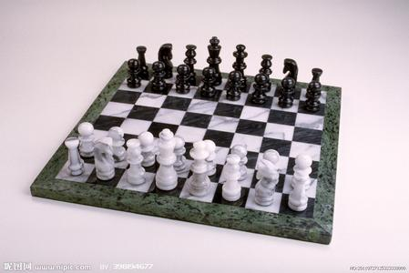
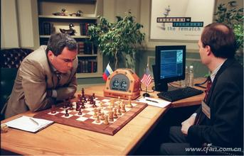
How does the computer recognize the chess board and play chess by itself?
Chess
2

Slide 3
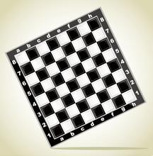
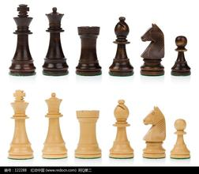
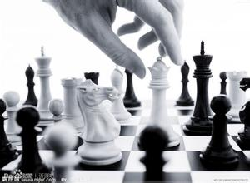
Procedure
Corner detection
Cell recognition
Chessboard reconstruction
Pieces detection
Recognition of the process of playing
Real-time playing and data visualization
3

Slide 4
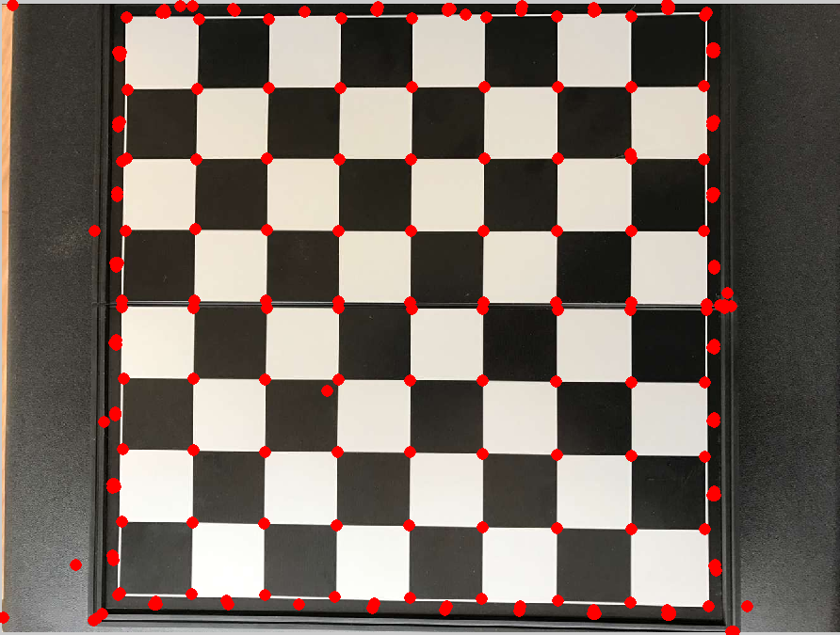
Corner detection
Median filter
Corner detection
4

Slide 5
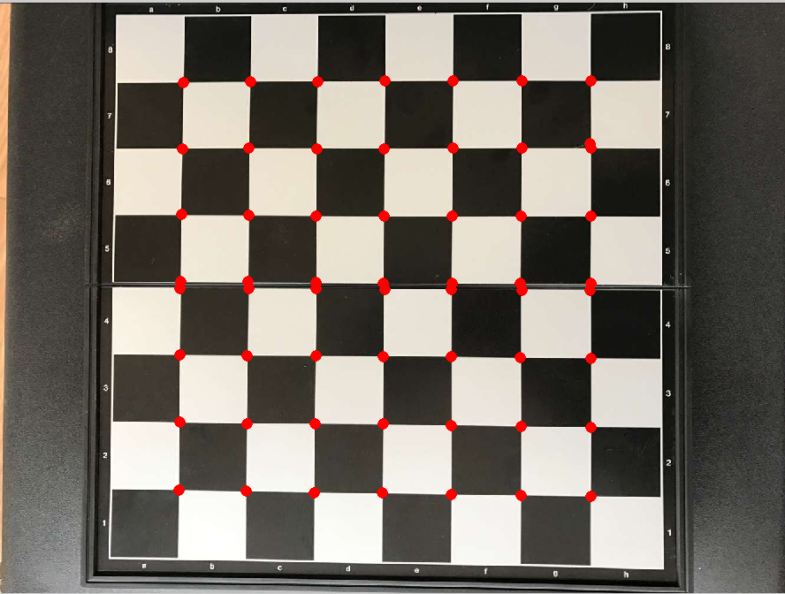

Cell recognition
What we know:
Cells are black and white
How to recognize:
Calculate Haar feature
Point whose Haar feature is larger than the threshold is a intersection point.
5

Slide 6
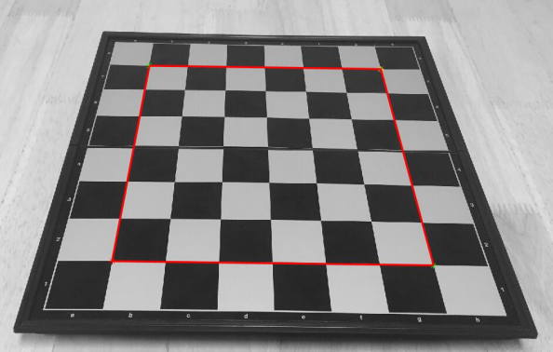
Chessboard reconstruction
Find the upper-left, upper-right, lower-left, lower-right points.
Other points are the linear combination of these four points.
6

Slide 7
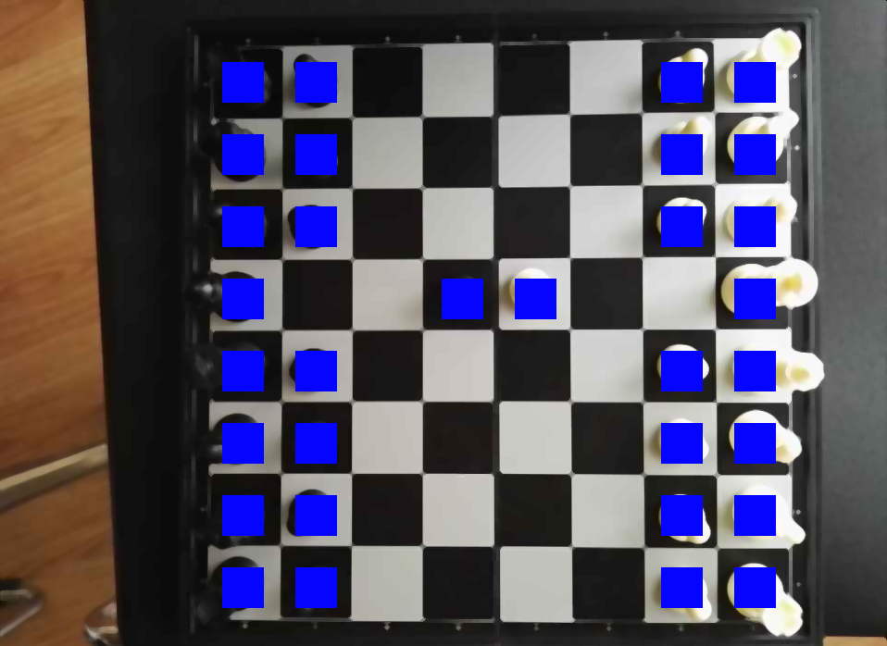
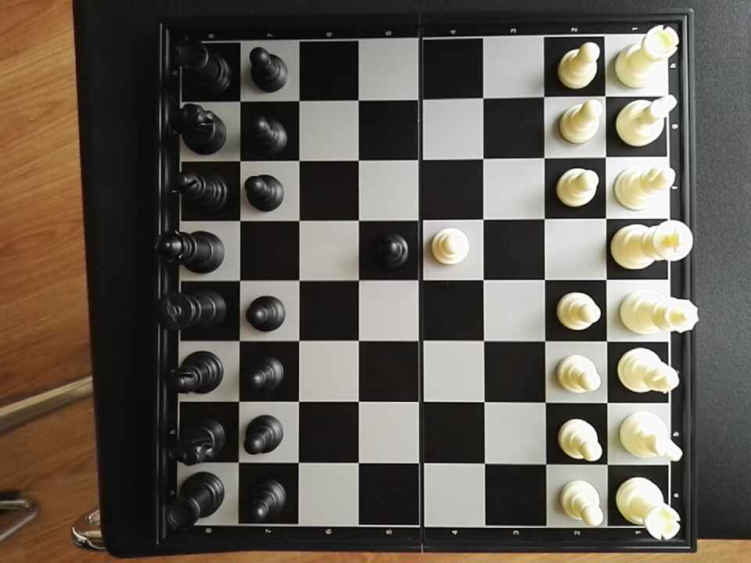
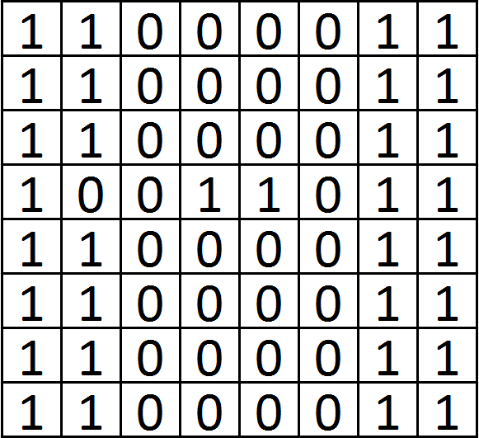
Pieces detection
Calculate the difference
of the largest and
smallest intensity in a
single cell.
The cell with a big difference is a cell with a piece on it.
7

Slide 8
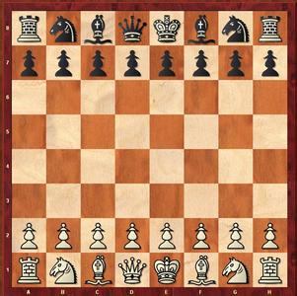
Recognition of the process of playing(1)
What we know:
The initial state of a game
8

Slide 9
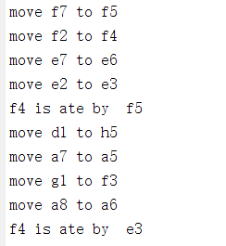
Recognition of the process of playing(2)
Compare two state matrices.
Then we know what happen:
move or attack.
9

Slide 10
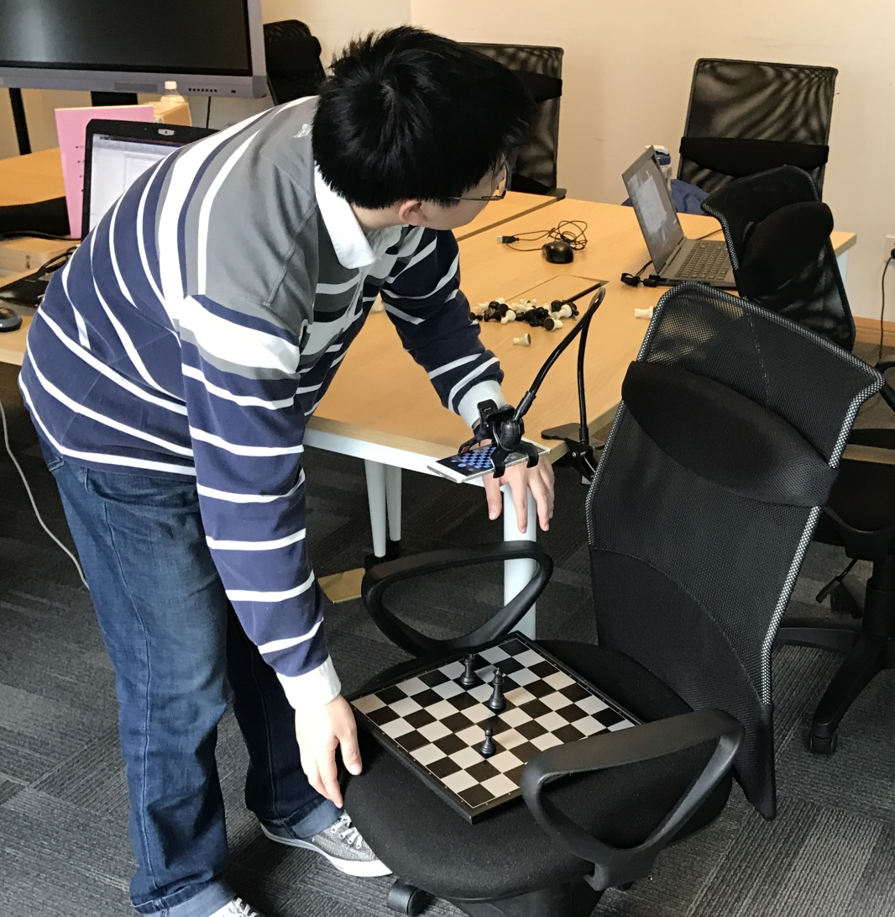
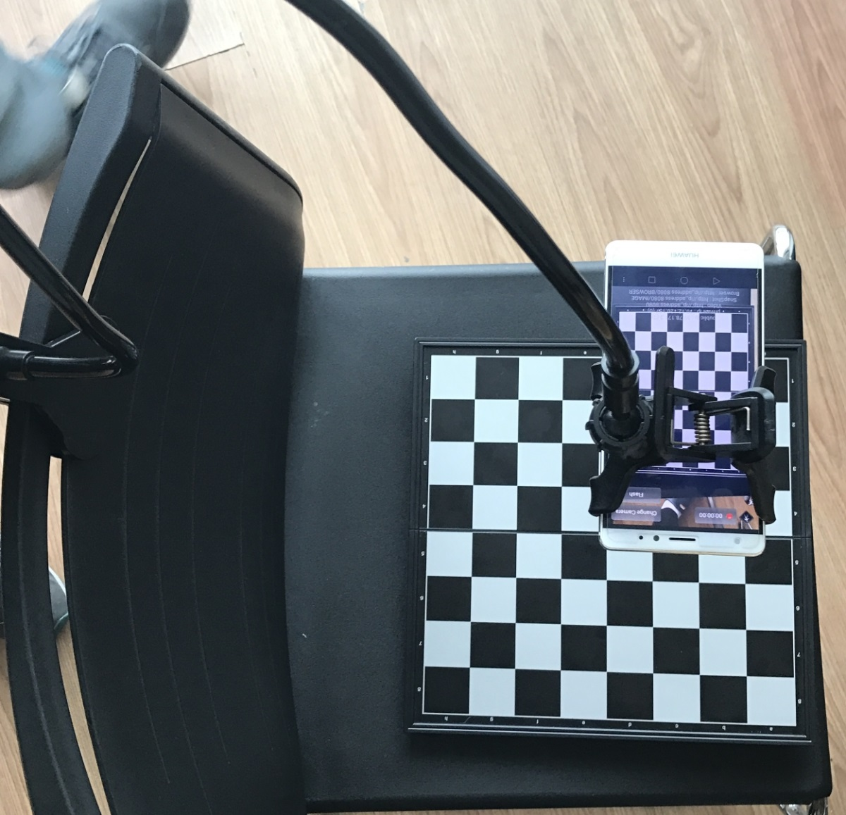
Real-time playing
10

Slide 11
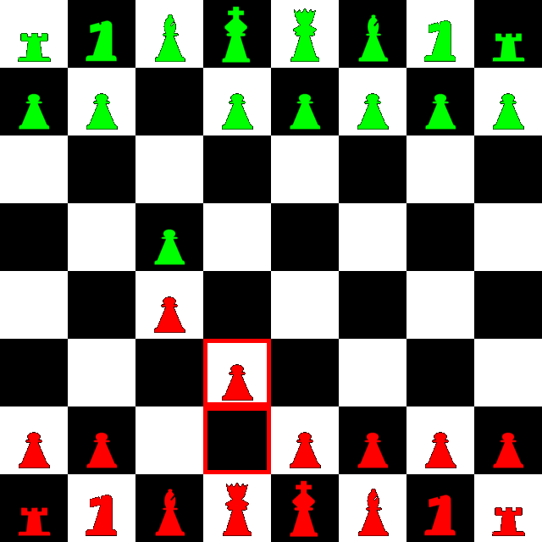
Data visualization
11

Slide 12
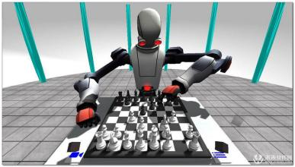
What can we do in the future?
Strengthen the intensity robustness
Strengthen the rotation robustness
Pieces recognition without prior knowledge
Connection to a chess AI and a robot
12

Slide 13
Thank you

